Slide 1
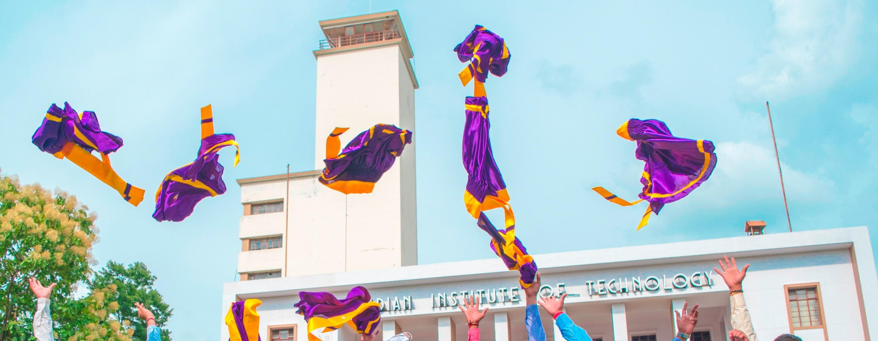
Self Esteem Stress and Happiness
Rajlakshmi Guha
Rekhi Centre for Happiness
IIT Kharagpur

Slide 2

Objectives…
What is self esteem and what are its components?
Is Happiness correlated to self esteem? Do happy people always have positive self esteem? Are people with high self esteem always happy?
What makes them different from low self esteemed people during a stressful situation
Perceiving it from the students’ perspective:
Is stress good or bad?
Do difference in self esteem determine response to stress?
How to manage stress?

Slide 3
A few concepts….
Perception of ourselves. Mental model of an individual’s own abilities and attributes
Self concept
Self Efficacy
Self awareness
Self ideal
What we would
like to be
set of beliefs that one can perform adequately in a particular situation
Being conscious / aware of personally experienced events

Slide 4
What is Self esteem?

Slide 5
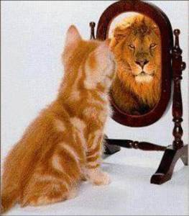
What is Self Esteem?
Self esteem: a global feeling of self-worth or adequacy as a person, or generalized feelings of self-acceptance, goodness, and self-respect
Coopersmith, 1967; Crocker and Major, 1989; Rosenberg, 1965;
It refers to the way we see and think of ourselves

Slide 6
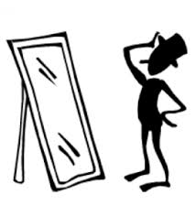
A look at your self esteem…

Slide 7
STATE SELF-ESTEEM SCALE
Heatherton, T. F. & Polivy, J. (1991). Development and validation of a scale for measuring state self esteem, Journal of Personality and Social Psychology, 60,
895-910

Slide 8
Instructions:
This is a questionnaire designed to measure what you are thinking at this moment. There is of
course, no right answer for any statement. The best answer is what you feel is true of yourself at
the moment. Be sure to answer all of the items, even if you are not certain of the best answer.
Again, answer these questions as they are true for you RIGHT NOW

Slide 9
Not at All A Little Bit Somewhat Very Much Extremely (1) (2) (3) (4) (5)
No. | Items | Score
1. | I feel confident about my abilities
2. (R) | I am worried about whether I am regarded as a success or failure.
3. | I feel satisfied with the way my body looks right now
4. (R) | I feel frustrated or rattled about my performance
5. (R) | I feel that I am having trouble understanding things that I read
6. | I feel that others respect and admire me
7. (R) | I am dissatisfied with my weight
8. (R) | I feel self-conscious
9. | I feel I am as smart as others
10. (R) | I feel displeased with myself

Slide 10
Not at All A Little Bit Somewhat Very Much Extremely (1) (2) (3) (4) (5)
No. | Items | Score
11. | I feel good about myself
12. | I am pleased with my appearance right now
13. (R) | I am worried about what other people think of me
14. | I feel confident that I understand things
15. (R) | I feel inferior to others at this moment
16. (R) | I feel unattractive
17. (R) | I feel concerned about the impression I am making
18. (R) | I feel that I have less scholastic ability right now than others
19. (R) | I feel like I'm not doing well
20. (R) | I am worried about looking foolish

Slide 11
Scoring:
Items 2, 4, 5, 7, 8, 10, 13, 15, 16, 17, 18, 19, 20 are reverse-scored
Sum scores from all items and keep scale as a continuous measure of state self esteem
The subcomponents are scored as follows:
Performance Self-esteem items: 1, 4, 5, 9, 14, 18, 19.
Social Self-esteem items: 2, 8, 10, 13, 15, 17, 20.
Appearance Self-esteem items: 3, 6, 7, 11, 12, 16.

Slide 12
Why talk about self esteem in a session on happiness?

Slide 13
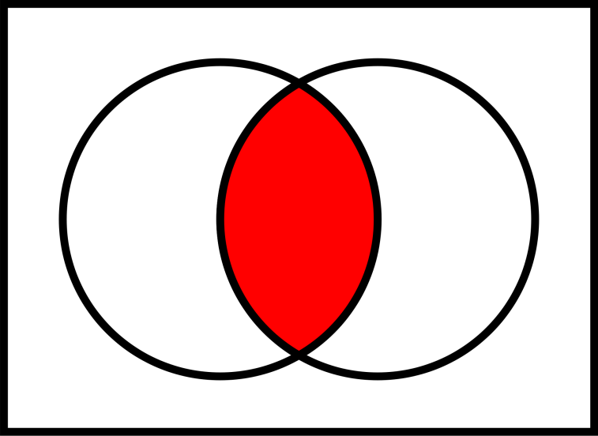
Is Self esteem and Happiness related? What does research say?

Slide 14
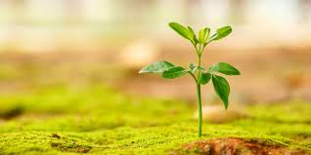
Correlates of happiness
Traits and dispositions: Four traits consistently characterize happy people
Self Esteem
Optimism
Extraversion
Sense of mastery or control

Slide 15

Correlates of happiness
Social Affiliations: Personal relationships
Kahana et al., 1995; Myers and Diener, 1995
Loneliness is inversely correlated with happiness, especially in older adults and positively correlated with depression
Lee and Ishii-Kuntz, 1987; Seligman, 1991
Close friendships can help buffer stress and avert distress due to loneliness, anxiety, boredom, and loss of self-esteem
Reis, 1984; Peplau and Perlman, 1982; Argyle, 1987

Slide 16
Correlates of happiness
Positive moods: The experience of happiness is marked by more frequent positive affective states than negative ones
Satisfaction with life: happy individuals demonstrate both global satisfaction with their lives and satisfaction within specific life domains such as work, recreation, friendship, marriage, health, and the self
Satisfaction of psychological needs: competence, autonomy, and relatedness
Deci and Ryan, 1985

Slide 17

Individuals with Positive Self esteem…
High Confidence
Sense of Optimism and lack of hopelessness
Sense of mastery and control
Resilient to self image threats
Low anxiety
Less vulnerable to depression
Savor positive affect
Lyubomirsky e al, 2005

Slide 18
An interesting study…
A contrast of Happy and Unhappy people
Lyubomirsky, S. & Ross. L (1997): Hedonic consequences of social comparison: contrast of happy and unhappy people.
Journal of Personality and Social Psychology, 73, 1141-1157
Happy participants provided with information that peers had done better /worse showed virtually no decline in mood
Unhappy participants showed more positive mood on receiving information that their peers had performed worse than them – SOCIAL COMPARISON MORE IMPORTANT
IS EMPATHY A TRAIT OF HAPPY PEOPLE?

Slide 19
more findings…
Unhappy individuals →more reactive to outcomes of trivial choices and important life decisions
Lyubomirsky & Ross, 1997
Unhappy people → react as if all outcomes are fraught with extreme pleasant / unpleasant consequences,
Happy people are more selective in their reactions

Slide 20
happiness → uniquely related to mood, temperamental traits, global life satisfaction, and social affiliation
Self esteem → more closely related to the agentic dispositions of optimism and mastery

Slide 21
How to raise your self esteem
Practice self-care
Identify triggers to low self-esteem.
Reduce personalizing
Stop and take notice
Acknowledge your responses
Choose response
Accept your responses

Slide 22
Are people with high self esteem always happy?
What makes them different from low self esteemed people during a stressful situation?

Slide 23
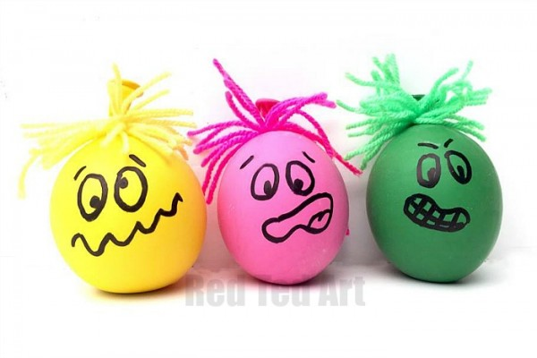
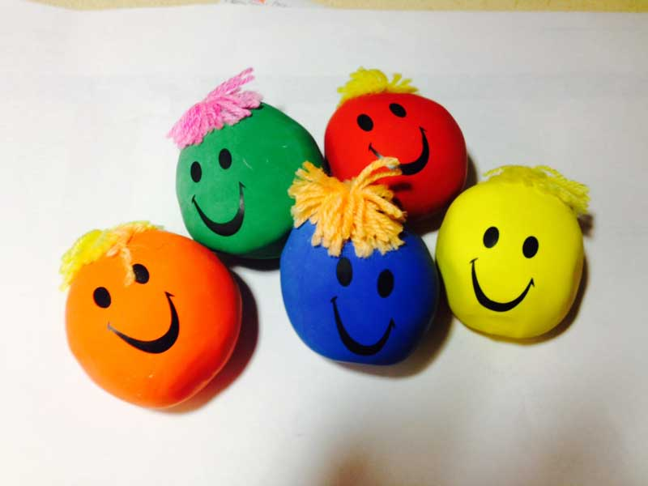
The role of stress in happiness

Slide 24
What is stress?
Stress can be defined as a response of the body to any demand placed on it
Stress can be influenced by both
external and internal factors
Major sources of stress in student life?

Slide 25
Greenberg, J. 2012

Slide 26
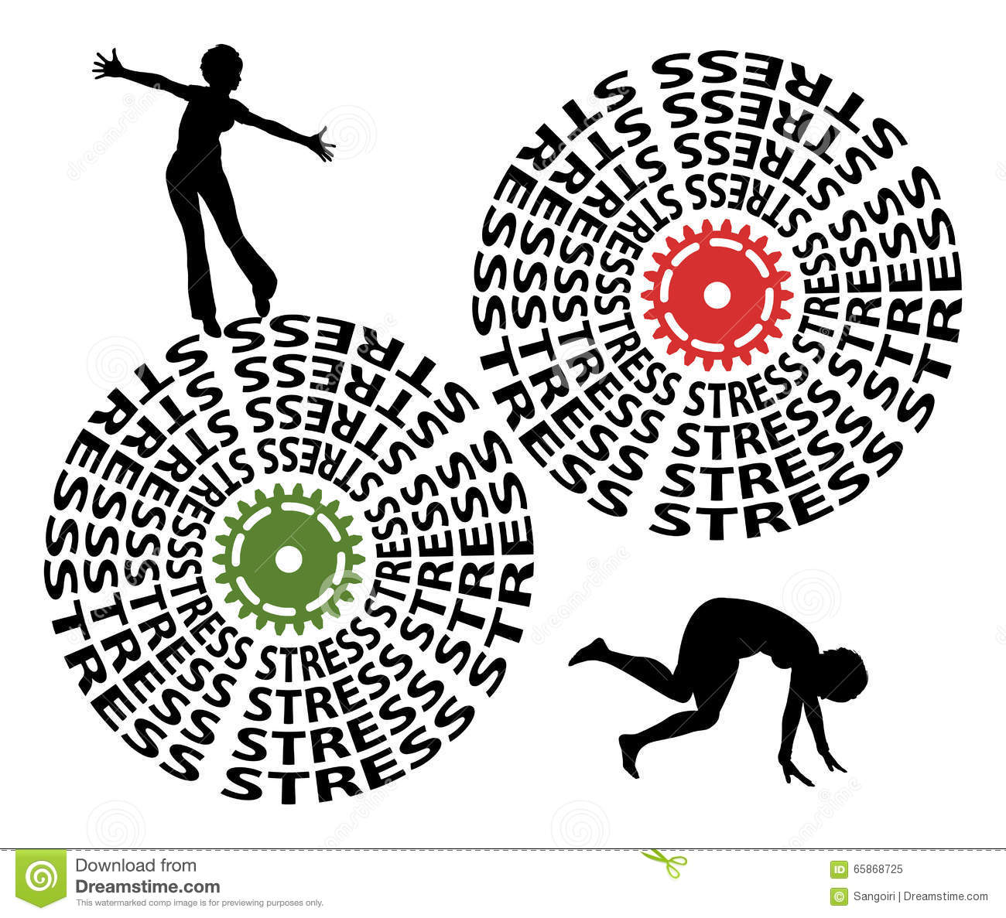
Is stress good or bad?

Slide 27
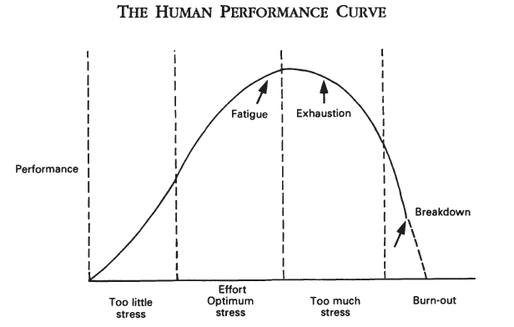
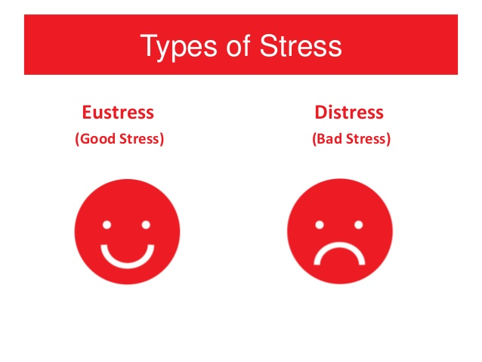
Not all Stress is bad….

Slide 28
Stress signals
Here are a few common indicators:
Difficulty concentrating
Increased worrying
Trouble completing assignments on time
Not going to class
Short temper or increased agitation
Tension
Headaches
Tight muscles
Changes in eating habits (e.g., “stress eating”)
Changes in sleeping habits

Slide 29
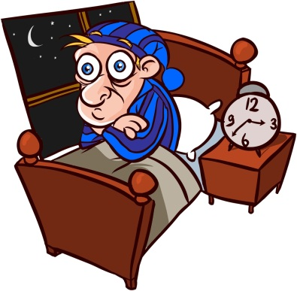
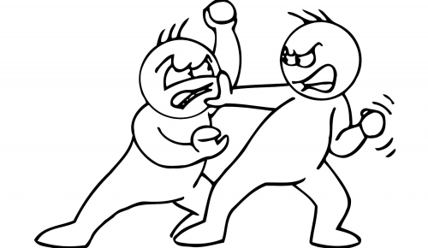
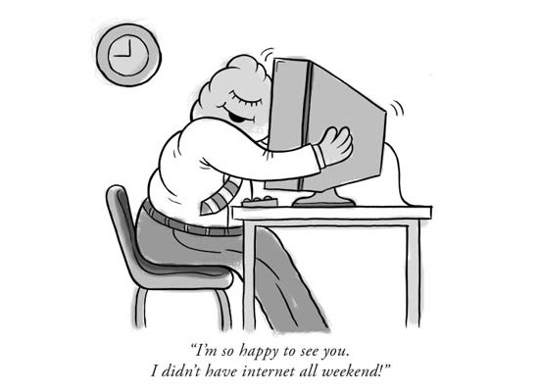
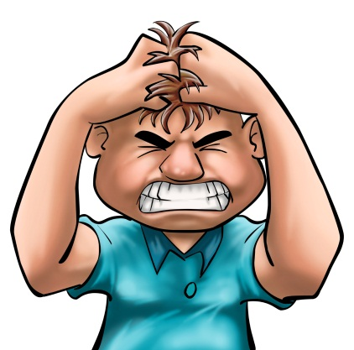
Effects of stress
Sleep disturbance
Avoidance behaviour → Absenteism
Poor academic performance
Internet / computer addiction
Social isolation – fights / arguments / conflicts
Alcoholism and substance abuse
Headache
Obesity / loss of weight
Digestion problems – Irritable Bowel syndrome
Clinical depression
Anxiety Disorders

Slide 30
Does a difference in self esteem determine response to stress?

Slide 31
differential behaviour during stress…
What is stressful to one person may be a refreshing challenge to another, depending upon his perception of the situation as well as his perception of his ability to cope with that situation

Slide 32
differential behaviour during stress…
The individual's judgment that a stressful situation exists, initiates a stress response
Without this appraisal there is no stress in the person's psychological schema (thought)
Even if a situation is perceived as a demand or threat it may still not mobilize a stress response if the individual thinks that he is able to cope with it adequately, either on his own or with the help of external resources or support from other people in his life
Lazarus and Folkman (1984); Schneiderman et al., 2005

Slide 33
Self esteem and stress…
Ex: “I can handle this,” – planning ways to handle the situation
“This is terrible. I’m going crazy” - quitting, getting more anxious
low self-esteem – Take fewer steps to fight back from negative life outcomes (substance abuse, delinquency, unhappiness, depression)
Leary and McDonald, 2003
High self esteem - face stressors as a challenge
(happiness and longevity)
Baumeister et al., 2003

Slide 34
Assessment COHEN-PERCEIVED-STRESS-Scale.pdf

Slide 35
Stress Management

Slide 36
Self help
A positive attitude to help yourself to bring about a change
Tell yourself:
“I am not helpless – the situation is making me feel so. I just need to bring about a few changes to make the situation better”

Slide 37
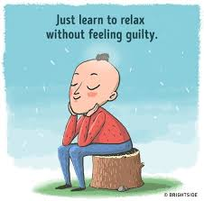
Strategies to ventilate, or express, the stress response
Practicing relaxation techniques
Regular exercise
Practicing assertiveness
Time management techniques
written expression

Slide 38

Interventions to reduce stress
Interventions decreasing stress and increasing happiness are:
exercise
meditation
written expression
Compton 2005; King 2001; Lyubomirsky et al. 2006

Slide 39
Time management
To do list:
Break a problem / topic into small parts
put it priority wise
fix a time of day to write down next day’s agenda - preferably before going to bed
Stick to your commitments
Evaluate - at the end of the day evaluate how much was done – what went right/ what went wrong
Reward yourself

Slide 40
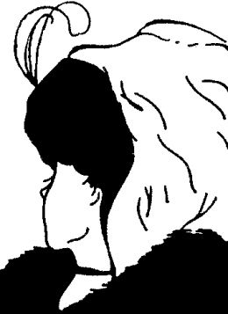
“Men are disturbed not by things, but by the views which they take of them” (Epictetus)

Slide 41
Thank you

